Slide 1
@Orwellyouthprize – Instagram
@Orwellyouthpriz – Twitter
#OYP2024 #HOME
THE ORWELL YOUTH PRIZE
GAME DESIGN

Slide 2
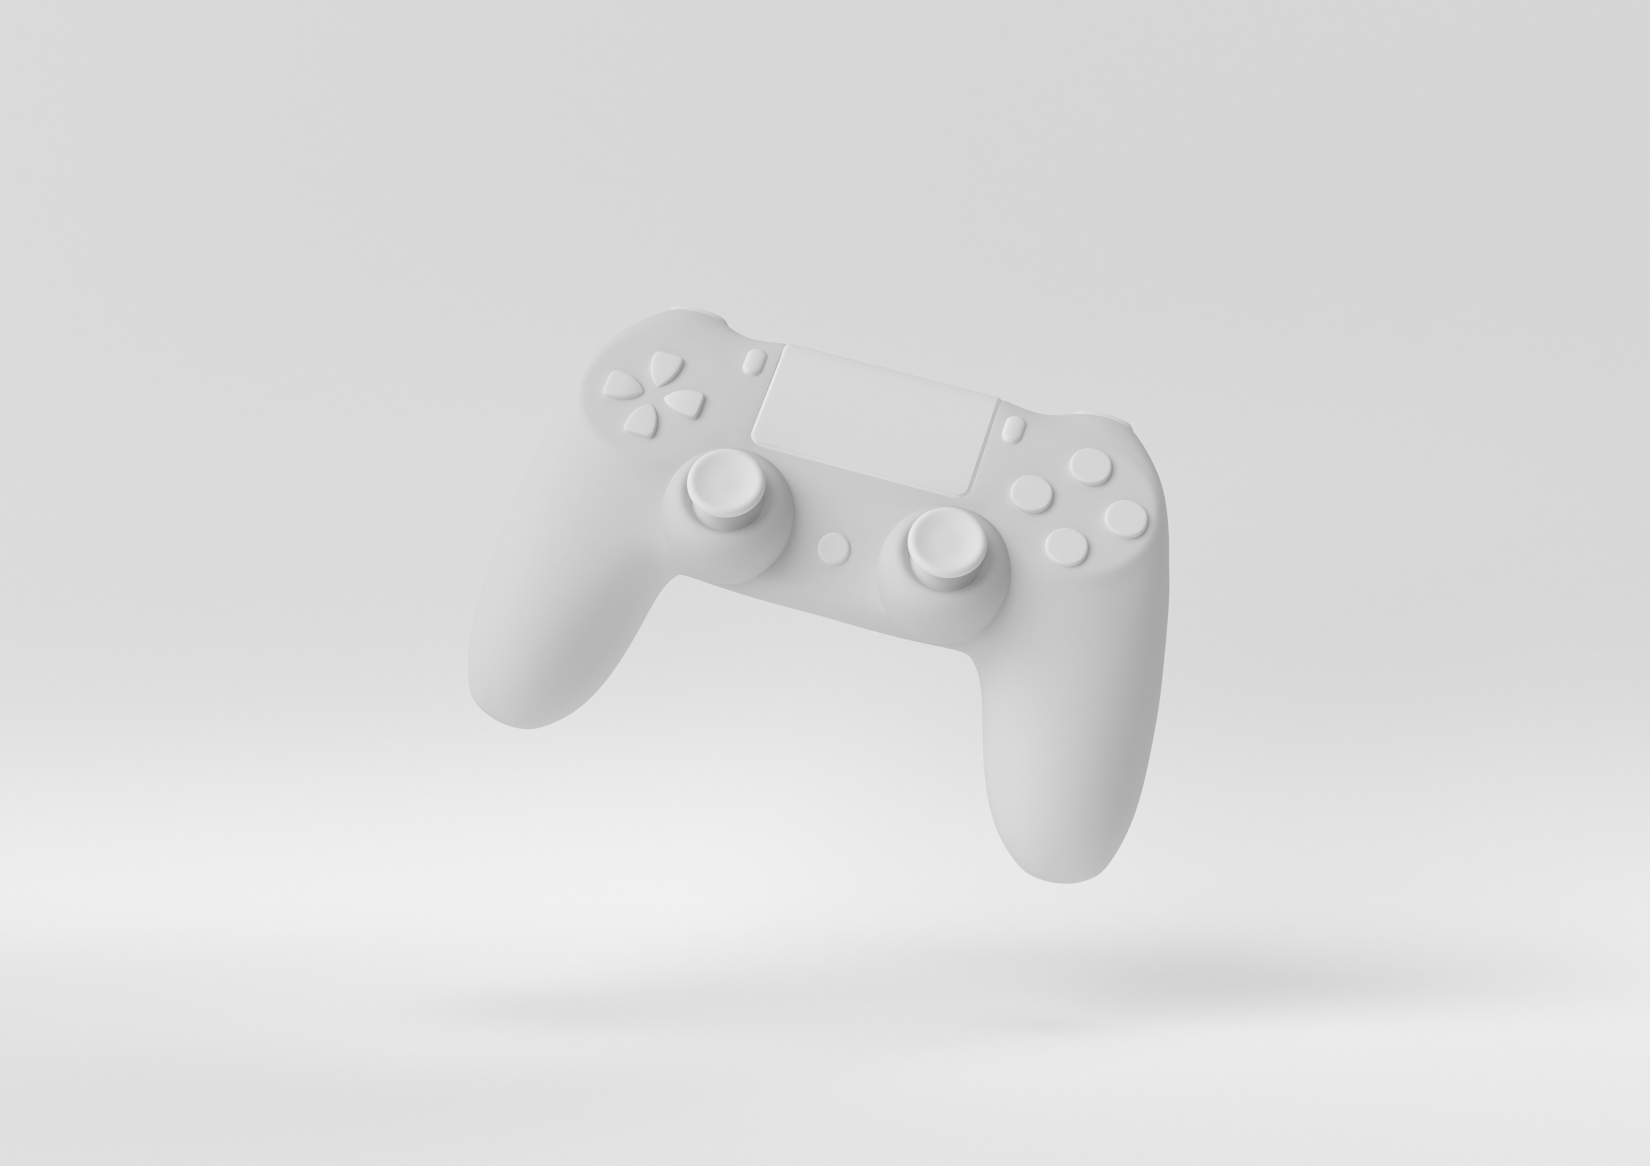
Why Pick Game Design?
Interactive form of media
Fully immerse the audience
Multilayered form of storytelling
You like playing video games
Notes:
Why pick Game design
If you came from the ‘find your form’ survey on the website or just interested, you may want to pick game design because it is:
An interactive form of media - As it requires the audience to participate your work and form a connection with it
You can fully immerse the audience - Especially with platforms like VR, the audience can
Multilayered form of storytelling - Whilst telling your story, you can accompany it with graphics and sound to represent your ideas. With no limit on what is physically possible
You like playing video games
So, how do you do game design? Most video games start out with a game design document, in which all of the details are outlined before development starts. They are useful are usually worked on in teams, so all of the members have a point of reference. This presentation will go over some of the features of a game design document and may be useful in your entry for the Orwell Youth Prize.

Slide 3
Game Name + Overview
Why Names Matter
What is a Game Overview?
They are one of the first impressions. Memorability is key.
One or two sentences describing what a game is about.
How to Write a Game Overview
Game Name Ideas
After the main character
After an existing theme
After a mechanic
After the setting
Briefly mention the problem in your story and the main mechanics of the game.
Notes:
Game name + Game overview
Why names matter
They are one of the first impressions your game will make. Memorability is key. When said in conversation, you want it to not only be easy to say but also that people can remember it. Whilst having a short name is good, it is also important that it remains unique.
Game name ideas
After the main character - Marvel’s Spiderman is named after the main character and comic book hero
After an existing theme - The Call of Duty franchise is named after the call to war, which forms the basis of the campaign in each game
After a mechanic - For example, the game portal is named after the ability to shoot portals which you use to traverse through levels
After the setting - Stardew valley is named after the place where the character resides
What is a game overview
One or two sentences describing what a game is about. It gives someone an understanding of the project at a quick glance
How to write a game overview
Briefly mention the problem in your story and the main mechanic of the game.

Slide 4
Theme
What is a Theme?
Examples of Themes
An underlying message behind your game.
Love
Power
Happiness
Hope
Family
How is Theme Different to Story?
How Do I Pick a Theme?
Either pick a theme and base your story off of it. Or, simplify your story to its smallest components to find its theme.
The story provides the means of conveying the theme.
Notes:
Theme
What is a theme?
An underlying message behind your game.
Examples of themes
Love
Power - Orwell explores the theme of power in his novel 1984, the power of the totalitarian state Oceania and the power of an individual man
Happiness
Hope
Family
How is theme different to story
The story provides the means of conveying the theme. For example, whilst the story of Cinderella is about a girl who loses her shoe fundamentally, it is about how love conquers all and how good triumphs over evil
How do I pick a theme?
Either pick a theme and base your story off of it. Or simplify your story to it's smallest components to find it's theme

Slide 5
Main Character(s)
What Makes a Good Main Character?
How Many Main Characters?
Try to have as few as possible, so that you can focus on developing them.
There are no definable traits. Just as long as they are memorable.
Examples of Character Pairings
Why are Character Pairings Important?
Parent and Child
Friends
Romantic interests
Partnership
The relationships between characters may affect the storyline or goal achieved by the end of the game.
Notes:
Main character(s)
What makes a good main character
There are no definable traits. Just as long as they are memorable.
How many main characters
Try to have as few as possible. So that you can focus on developing them.
Examples of character pairings
Parent and child - In ‘The last of us’ there is a father-daughter relationship between the games leads, Joe and Ellie
Friends - The ‘Tomb Raider’ games sometimes pairs Lara croft with a friend that she explores locations with
Romantic interests - ‘It takes two’ follows a husband and wife with a failing relationship as they work together to become human again.
Partnership - In ‘A way out’ two convicts join forces to escape prison together
Why are character pairings important
The relationships between characters may affect the storyline or goal achieved by the end of the game. You want to have characters that have good chemistry with one another as well as ones that represent your theme.

Slide 6
Story Overview
What is a Story Overview
What is Story Structure
Summary of the story line at each of its key parts.
The order in which the story is told, broken up into different sections.
Example Story Structure
Freytag’s Pyramid
Exposition - Explains the background of the story
Rising Action - Sets the story into motion
Climax - Tipping point of the story, will or won’t they achieve their goal
Falling Action - Shows the after effects of the climax
Resolution - Shows the longer lasting effects of the climax
Notes:
Story Overview
What is a story overview
Summary of the storyline at each of its key parts.
What is story structure
The order which the story is broken up into different sections.
Example story structure
Whilst there are many story structures out there, for my example I have chosen to use Freytag’s pyramid. It goes slightly more in depth than the beginning-middle-end structure.
Exposition - Explains the background of the story Explores the world and characters prior to the inciting incident. Try to keep this brief as it does not add much, try to avoid daily mundanity unless it links to your theme
Rising Action - Sets the story into motion. Here is where the inciting incident is, as well as the build up to the boiling point of the story. Develop character relationships and increase the stakes and tension.
Climax - Tipping point of the story, will or won’t they achieve their goal? Character relationships should be tested and at its end there should be a clear difference from the beginning of the game.
Falling Action - Shows the after effects of the climax. Do the characters regret what they’ve done? What are the immediate impacts?
Resolution - Shows the longer lasting effects of the climax. Doesn’t need to be set long after the events of the story. But, what it should show is the final change in character relationships and even their environment from the beginning of the game

Slide 7
Gameplay
Rules + Goals
Why are Gameplay Rules Important?
Gameplay Rules Examples:
Leaving the play area results in death
No friendly fire
No restarts
The rules can provide the challenge of the game and give basic coding parameters.
What are Gameplay Goals?
Gameplay Goal Examples:
What the player needs to achieve to pass the levels.
Collecting an object
Reaching a specific area
Finishing all of the level objectives
Notes:
Gameplay (Rules + Goals)
Why are gameplay rules important?
They can provide the challenge of the game and give basic coding parameters. They are a repeatable ruleset that can easily be copied across all levels of the game
Gameplay rules examples:
Leaving the play area results in death - In platformers if you drop into gaps left open at the bottom of the map then you die and are usually forced to restart at a checkpoint or a the beginning of the level
No friendly fire - In some first-person shooters, if you shoot your teammates you may receive the loss of health points
No restarts - Very common in retro video games, if the player were to lose the level you’d have to restart the game from the very beginning
What are gameplay goals?
What the player needs to achieve to pass the levels.
Gameplay goal examples:
Collecting an object - For instance, you may have to solve a series of puzzles to acquire a token to move on
Reaching a specific area - In platformers like ‘Mario’, you have to make it to the end of the map before moving onto
Finishing all of the level objectives

Slide 8
Gameplay
Mechanics
What are Gameplay Mechanics?
Examples:
Flight
Character customisation
Shooting
Teleporting
Choices
They are the functions in the game, not to be confused with the rules.
Why are Mechanics Important?
Which Should I Use?
Start with your theme and story overview. Would it suit the world and story you are creating?
Not only do they allow the player to interact with the game, they also can be used as a means of storytelling.
Notes:
Gameplay - Mechanics
What are gameplay mechanics?
They are the functions in the game, not to be confused with the rules.
Gameplay mechanic examples:
Flight
Character Customisation
Shooting
Teleporting
Choices
Why are mechanics important?
Not only so they allow the player to interact with the game, they can also be used as a means of storytelling. For instance, games that implement different storylines dependent on the user’s input utilise a choices mechanic.
What ones should I use?
Start with your theme and story overview. Would it fit the world and story you are creating? Mechanics should support your story, theme and the vice versa.

Slide 9
Gameplay
Items and Power Ups
What are Items and Power Ups?
Tips for Balancing:
Player accessible objects that enhance a specific ability in the game.
Making sure that the items and power ups are not overpowered.
Examples of Items and Power Ups:
What is Balancing?
Add a drawback
Add a limit of how many can be stored
Certain items can only be used independently
Potions
Food
Currency
Notes:
Gameplay (Items and Power ups)
What are items and power ups?
Player accessible objects that enhance a specific ability in the game.
Items and power ups examples:
Potions
Food
Currency
What is balancing?
Making sure that the items and power ups are not overpowered. Especially in online-based player versus player combat, you do not want to make the game unplayable for people that do not have certain items
Tips for balancing:
Add a drawback - For instance, though speed may be increased by 50%, heath is decreased by 25%
Add a limit of how many can be stored - Having a stack limit for all items is a good idea in addition to only allowing one of a particularly powerful item to be stored
Certain items can only be used independently - Which means that certain buffers or boots cannot be used simultaneously, as it would grant too much power to the user

Slide 10
Gameplay
Challenges + Rewards
What are Challenges?
What are Rewards?
Extra objectives/ game modes that the player can complete for rewards.
Items given after the player completes main objectives and challenges.
Challenge Examples:
Reward Examples:
Time trials
Endless mode
No restarts
One gun
Social trophies
Currency
Item unlocks
Map unlocks
Notes:
Gameplay (Challenges + Rewards)
What are challenges?
Extra objectives/ game modes that the player can complete for rewards.
Challenge examples:
Time trials
Endless mode
No restarts
One gun
What are rewards?
Items given after the player completes main objectives and challenges.
Reward examples:
Social trophies - Usually attributed to the users networked account.
Currency
Item unlocks
Map unlocks

Slide 11
Gameplay
Losing
What is losing?
Results of Losing - Examples:
When the player fails to achieve an objective or dies.
Lose access to a character
Lose items and power ups
Have to restart the level
May lose currency
How Do I Pick the Penalties?
Think about your demographic, story and theme.
Notes:
Gameplay (losing)
What is losing?
When the player fails to achieve an objective or dies
Results of losing examples:
Lose access to a character - Whether it's having the character permanently die altering a choices based narrative or just having them be unable for selection in more arcade-based games
Lose items and power ups - For instance, you may lose your inventory and levels in minecraft after dying and other players are able to collect your stuff
Have to restart the level - In platformers, you are usually put back at a checkpoint if you die
May lose currency - For example, in GTA V story mode, if you die, you have to pay in-game currency to the hospital for reviving you. Which means you have less money to spend on whatever you like.
How do I pick the penalties?
Think of your demographic, story and theme. You wouldn’t want to have harsh penalties for a demographic that are prone to making mistakes as it will dishearten them and discourage them from playing. Equally, you wouldn’t want to have soft penalties for a demographic that would prefer a challenge - as the lack of difficulty will bore them. Furthermore, are your penalties in line with your story and theme. For instance, a story driven by personal choice should have dire effects on characters if they choose wrong.

Slide 12
Art and Sound
What is a Game Art Style?
Why is Sound Important?
It defines how you would like all of your assets to appear.
It sets the tone of the scene that you are showing.
Examples of Art Styles:
Examples of Music Genres:
3D
2D
Cartoon
Realistic
Painterly
Electronic
Classical
Rap
Pop
Notes:
Art and sound
What is a game art style?
It defines how you would like all of your assets to appear. By assets I mean all of the objects in your game, for instance, character models, buildings, vehicles etc
Examples of art styles:
3D - Very broadly, games can use 2D, 3D or both. With 3D models and objects, they have depth as well as width and height. Marvel’s Avengers is an example of a 3D game.
2D - Think of Mario, snake and tetris. All games which have no depth, each object presented as being flat on the screen
Cartoon - Usually takes the form of outlined objects or very stylised, non realistic representations of objects. An example of this is Overcooked, where all of the items do not appear as copies of their real life versions and the characters include animals.
Realistic - Very common in large studio releases nowadays. Objects are rendered to look as close as possible to the real life equivalent. Think of the graphics in Red Dead Redemption 3.
Painterly - Another example of style in graphics. An example of a painterly style in video games would be Disco Elysium.
Why is sound important?
It sets the tone of the scene that you are showing. For instance, when playing ‘Mario Kart’ and other arcade racers they utilise sound to increase tension by increasing the tempo. Therefore, you can also use sound to almost manipulate your audience into whatever feeling you would like them to feel.
Examples of music genres:
Electronic - Often associated with videogames. Usually found in 2D games, think of Terraria.
Classical - Sometimes blended in with electronic music
Rap - Can often be found in more mainstream/ general audience games that follow real life. For instance any of the NBA basketball games released. To match with the urban aesthetic associated with the sport
Pop - Usually played in games meant to emulate present day. Think of GTA V and its range of music stations.

Slide 13
Demographics
What is a Demographic?
How to Define a Demographic
A demographic is the intended end user of our game.
Use a combination of different demographics in order to be as specific as possible. For example:
Young adults from England
Why Define a Demographic?
Examples:
It gives specific ideas on how to enhance our game for user experience. It also allows people to effectively choose which games to buy.
Age
Gender
Race
Nationality
A specific disability(ies)
Notes:
Demographics
What is a Demographic?
In this case, a demographic is the intended end user of our game, often referred to as the player. It is important that we tailor our game to our demographic.
Examples of a demographic:
Age - Think of groups such as: Children, teenagers, adults and the elderly and how we can cater to each one. For instance, it would not be the best idea to make a game that requires intensive motor function like button mashing or precise jumping for young children
Gender - Whilst games should be comfortable for someone of any gender to play, you may want to explore a gendered experience and how it affects the world of the story. Whilst it is not a game, Julia, a book by Sandra Newman explores the world of 1984 through the lens of a woman in Oceania - a perspective not explored in the original novel
Race - The same goes for Race, you may want to explore the experiences of a certain race in your game.
Nationality - This is very important to the end user and the world that the story is set in. Language is a barrier that can be overcome by translation however, certain phrases and gestures cannot be expressed. Also, you may use plot points that are specific to a particular country, for example the setting of a secondary school rugby match is something that would be associated with the Uk and other rugby playing nations. But, not everyone may know what these are. So it would be beneficial to make the Uk our target audience of choice.
A specific disability - Disability accommodation in video games is very important. Think about elements you can include to make their experience better, for example including audio description for visually impaired users
Why define a demographic?
It gives specific ideas on how to enhance our game for user experience; rather than guessing. It also allows people to effectively choose which games to buy; reducing the chance of them wasting money and CD’s going to landfill.
How do define a demographic
Usually, you would use a combination of different demographics as possible in order to be as specific as possible. For example: young adults from England.

Slide 14
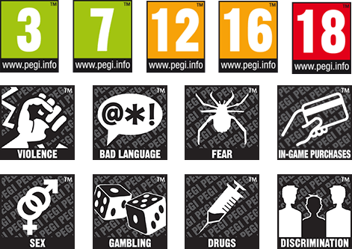
Demographics
Industry standard demographic markers
PEGI
PEGI was established to help European consumers make informed
decisions when buying video games or apps through the use of age recommendations and content descriptors.
https://pegi.info/
Notes:
Demographics (continued)
PEGI
Just as movies have age ratings, so do video games. If you live in Europe, you’ve probably seen the PEGI rating system on the games you buy.
PEGI was established to help European consumers make informed decisions when buying video games or apps through the use of age recommendations and content descriptors.
In your game design document, it could be helpful to look at PEGI and other industry standard demographic markers as they are clear on what is suitable for specific age ranges/ audiences. Though, if you don’t live in a country that uses PEGI, take a look at your countries rating systems for games

Slide 15
Demographics
Platforms
What is a platform?
Examples of platforms:
The target device for our game.
Console
Handheld
Desktop/PC
Mobile
VR
Why have a target platform?
How to pick a platform
Devices have different capabilities.
Complete the rest of the game design document. Think of the complexity of the graphics and mechanics.
Notes:
Demographics (platforms)
What is a platform?
The target device for out game. Whilst games are ported/ altered for release on other devices, a target device is useful in development to tailor the games controls and features to that particular platform
Examples of platforms:
Console - For instance, a PS5 or an XBOX 1S. These can handle high intensity games and graphics, due to them being purpose-built machines
Handheld - For instance, a PSP/ Vita or a Nintendo switch. While being purpose-built they cannot handle the intensity a console can due to the limiting factor of size and weight which restricts the components being used.
Desktop PC - Some machines are purpose-built gaming computers whilst others are general purpose which causes a wide range in performance capabilities.
Mobile - These are not purpose built and therefore can only handle low intensity games as they must perform other tasks. Also, think of controls, usually control of mobile games is limited to the touch screen which can affect sensitivity and be harder for people to control.
VR - Usually used with a console or pc, they can be used to fully immerse the player in the game
Why have a target platform
Devices have different capabilities. Personally, I think it is easiest to pick one platform, know it's capabilities and then think about upscaling it for other platforms or know that it cannot be delivered to certain platforms.
How to pick a platform
Complete the rest of the game design document. Think of the complexity of the graphics and the mechanics. As these ultimately decide which platform it can be played on. For example, a high-frame rate game with lots of game data would not be suited to be played on mobile. Equally, you may want to make a game that is accessible to as many players as possible, so you may choose to sacrifice complexity to be able to have it on the mobile platform

Slide 16
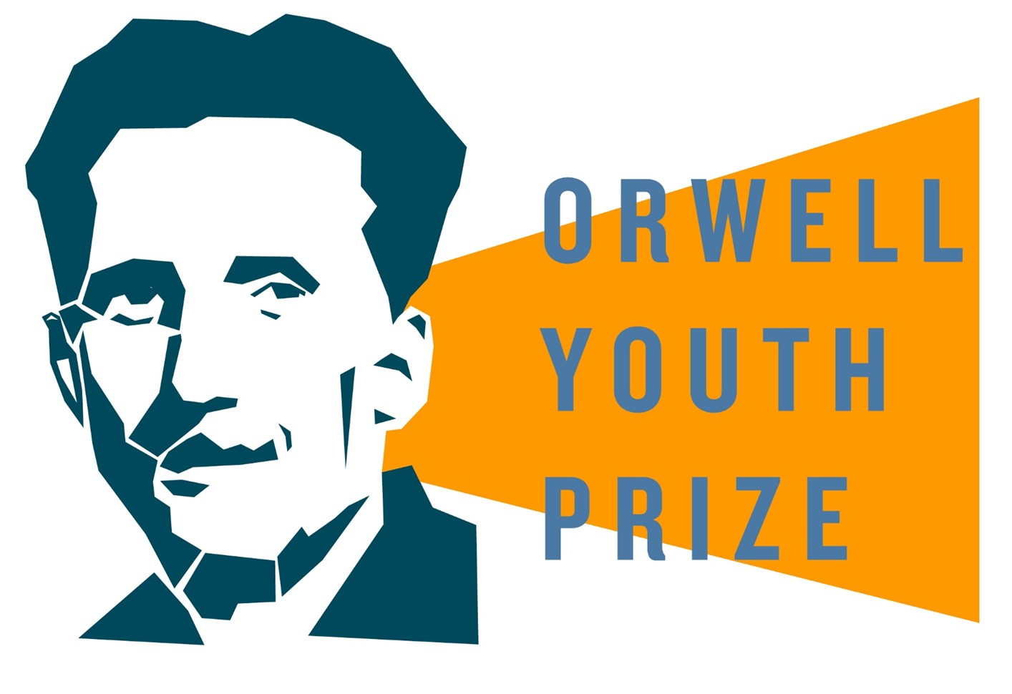
A REMINDER: There is no set way to make a game design document.
FIND OUT MORE:
www.orwellyouthprize.co.uk
@orwellyouthprize - Instagram
@orwellyouthpriz – Twitter
Notes:
A reminder
There is no set way to make a game design document. All of the ideas listed in the powerpoint are just an idea of how you could make it.

